Slide 1
Machine Learning
“A field of study that gives computers the capability to learn without being explicitly programmed."

Slide 2
REGRESSION

Slide 3
Recap
Regression is a statistical measurement used in finance, investing, and other disciplines that attempts to determine the strength of the relationship between one dependent variable and a series of other changing variables or independent variable

Slide 4
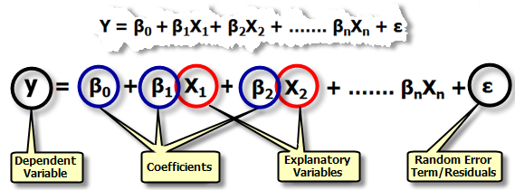
Multiple linear regression
Multiple regression is an extension of simple linear regression. It is used when we want to predict the value of a variable based on the value of two or more other variables. The variable we want to predict is called the dependent variable (or sometimes, the outcome, target or criterion variable).

Slide 5
Comparison:
Simple linear regression
Predict insurance premium vs person’s age
Independent variable(x) : Age
Dependent variable(y): Premium
Multiple linear regression
Predict insurance premium vs person’s age, and BMI (Body Mass Index)
Independent variable(x) : Age, BMI
Dependent variable(y): Premium

Slide 6
Polynomial regression
Polynomial Regression is a form of linear regression in which the relationship between the independent variable x and dependent variable y is modelled as an nth degree polynomial. Polynomial regression fits a nonlinear relationship between the value of x and the corresponding conditional mean of y, denoted E(y |x)

Slide 7
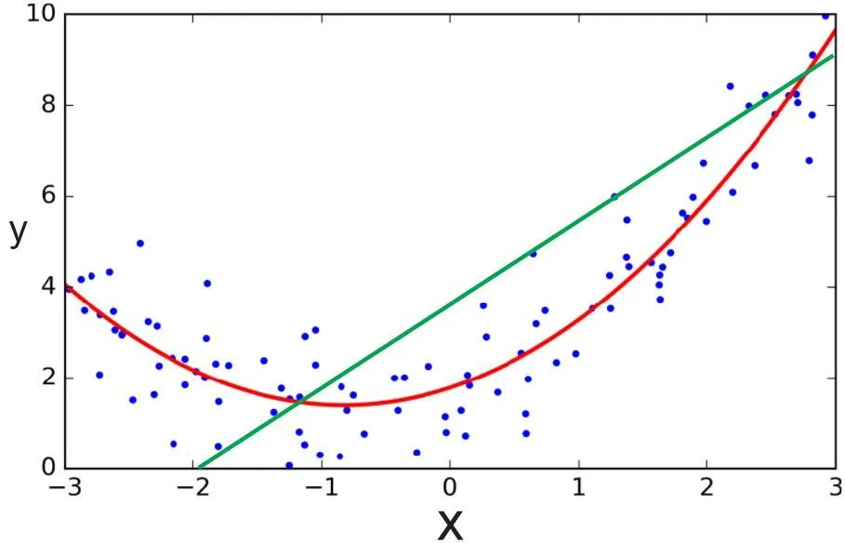

Slide 8
Let’s write some codes

Slide 9
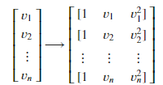
Polynomial regression cont’d
fit_transform takes our x values, and output a list of our data raised from power of 0 to power of 2 (since we set the degree of our polynomial to 2).
After, we can deal with it as 'linear regression' problem. Therefore, this polynomial regression is considered to be a special case of traditional multiple linear regression. So, you can use the same mechanism as linear regression to solve such a problems.

Slide 10
Decision tree regression
Decision tree builds regression models in the form of a tree structure. It breaks down a dataset into smaller and smaller subsets while at the same time an associated decision tree is incrementally developed.
The final result is a tree with decision nodes and leaf nodes. A decision node (e.g., Outlook) has two or more branches (e.g., Sunny, Overcast and Rainy), each representing values for the attribute tested. Leaf node (e.g., Hours Played) represents a decision on the numerical target.
The topmost decision node in a tree which corresponds to the best predictor is called root node. Decision trees can handle both categorical and numerical data.

Slide 11
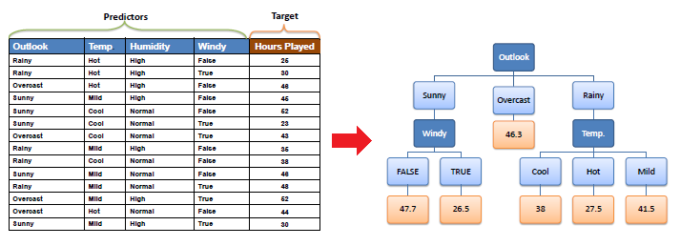
Decision tree approach

Slide 12
Decision tree Outputs
Decision tree regression analyzes the features of an object and builds a tree-structured model to make predictions, generating meaningful continuous outputs. Continuous output refers to results that are not confined to a predefined set of discrete values or categories.
For instance:
Discrete output: A weather prediction model that forecasts whether it will rain on a particular day.
Continuous output: A profit prediction model that estimates the potential profit from the sale of a product.

Slide 13
Random forest regression
The Random Forest is one of the most effective machine learning models for predictive analytics, making it an industrial workhorse for machine learning.
The random forest model is a type of additive model that makes predictions by combining decisions from a sequence of base models.
Here, each base classifier is a simple decision tree. This broad technique of using multiple models to obtain better predictive performance is called model ensembling.
In random forests, all the base models are constructed independently using a different subsample of the data

Slide 14
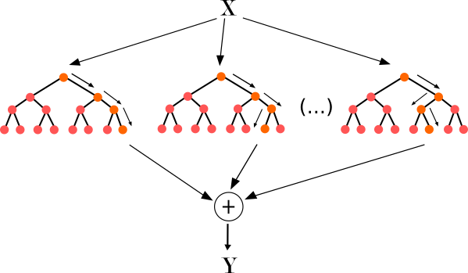
Random forest approach

Slide 15
Pros and cons
Regression model | Pros | Cons
Linear regression | Works on any size of dataset, gives information about features. | The Linear relationship assumption.
Polynomial regression | Works on any size of dataset, works very well on non linear problems | Need to choose right polynomial degree.
Decision tree recession | Interpretability, no need for feature scaling, works on both linear and non linear problems | Poor results on small datasets, overfitting can easily occur
Random forest regression | Powerful and accurate, good performance on many problems including non linear | Limited Interpretability, overfitting can easily occur, need to choose number of trees.

